Slide 1
Chapter 16

Slide 2
Objectives

Slide 3
Objectives (cont.)

Slide 4
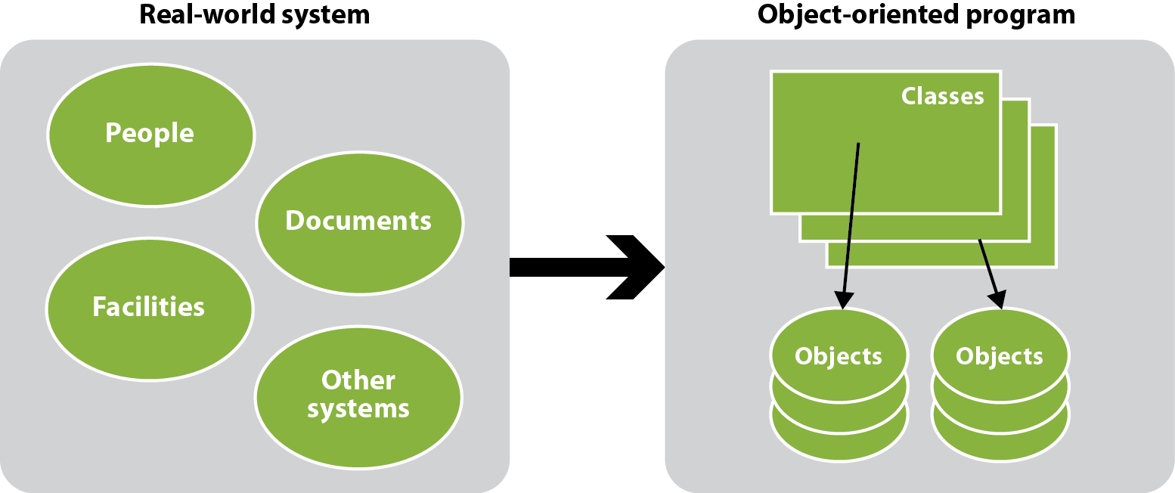
An object-oriented program is modeled after a real-world system

Slide 5
Five steps for designing an object-oriented program

Slide 6
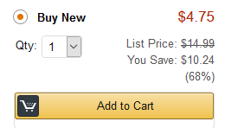
A screen capture that can be used to identify data attributes

Slide 7
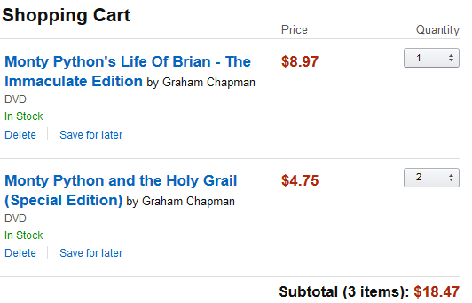
Another screen capture that can be used to identify data attributes

Slide 8
The data attributes identified from the screen captures

Slide 9
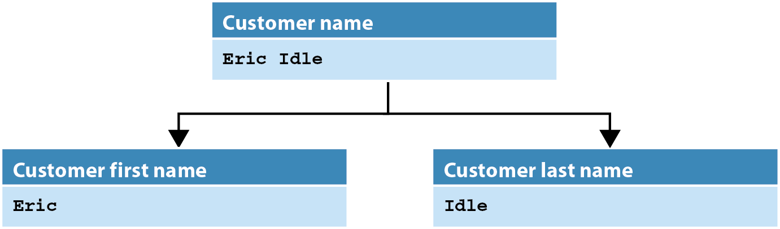
A customer name divided into first and last name

Slide 10
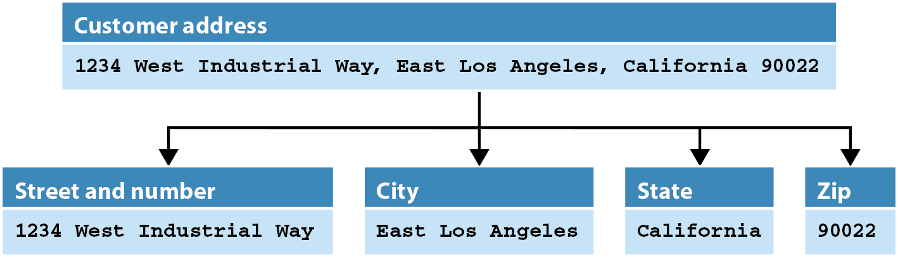
An address that’s divided into its components

Slide 11
Possible classes and attributes for a Shopping Cart program

Slide 12
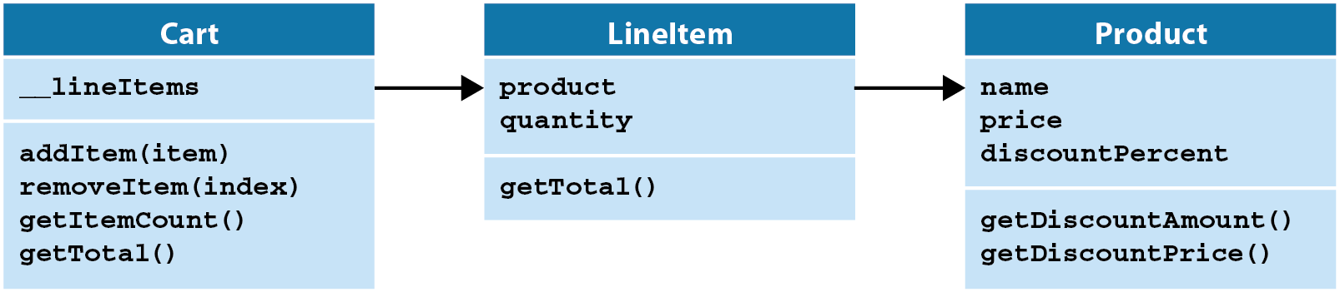
The UML diagram for the classes of the Shopping Cart program

Slide 13
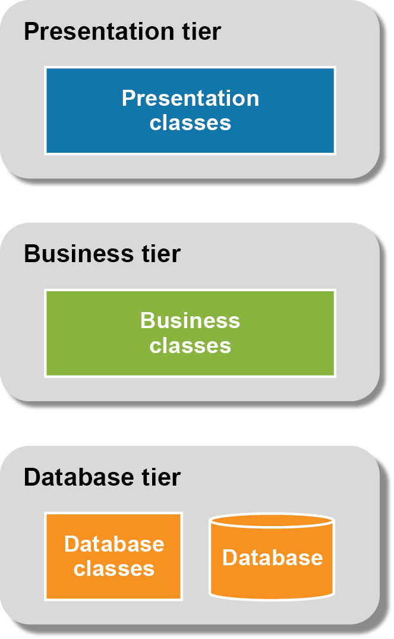
The three-tier architecture of an application

Slide 14
The business module

Slide 15
The business module (cont.)

Slide 16
The business module (cont.)

Slide 17
The products.csv file

Slide 18
The db module

Slide 19
Code that tests the database and business layers

Slide 20
The user interface

Slide 21
The user interface (cont.)

Slide 22
The shopping_cart module

Slide 23
The shopping_cart module (cont.)

Slide 24
The shopping_cart module (cont.)

Slide 25
The shopping_cart module (cont.)

Slide 26
The shopping_cart module (cont.)

Slide 27
The shopping_cart module (cont.)

